Slide 1
Car crashes in USA
Iskandarov Ravan
Akhundzada Haji
Hasanov Arzuman

Slide 2
Abstract
In this presentation, we explore US car crashes. We analyze when and why these accidents happen using spreadsheet tools. We first investigate the timing of accidents. We seek patterns in day, month, and time of day. Next, we dive into the reasons behind these accidents. We examine factors like driver inattention, passing to closely, driver inexperience, and vehicle types. Our focus is on data-driven insights to enhance road safety and reduce accident impact. By the end, you'll understand car crash dynamics and tools for prevention.
2

Slide 3
Motivation
01
Saves lives and reduces injuries
04
Minimizes economic costs
02
Shapes traffic safety policies
05
Influences driver behavior positively
03
Advances technology and autonomous vehicles
06
Drives innovation and prevention for safer roads
3

Slide 4
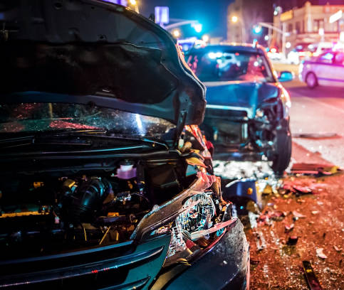
Dataset(s)
We sourced our dataset on car crashes from Kaggle.com, originally comprising over 1 million rows and 28 columns. To streamline our analysis, we reduced it to 42,544 rows and 8 columns.
4

Slide 5
Data Preparation and Cleaning
We collected “Car crashes” data from Kaggle. The data was very massive and we decided to make it simpler.To prepare the data for analysis, we have removed following columns:
5
ZIP CODE
LATITUDE
LOCATION
NUMBER OF PERSONS INJURED
NUMBER OF PEDESTRIANS KILLED
CONTRIBUTING FACTOR VEHICLE 4
COLLISION_ID
VEHICLE TYPE CODE (2,3,4)

Slide 6
Methods
COUNT/COUNTIF
IMPORTRANGE
SORT
FILTER
6

Slide 7
Research Questions
In what time interval did the accidents happen more often?
What types of cars have the most accidents?
What are the causes of accidents?
7

Slide 8
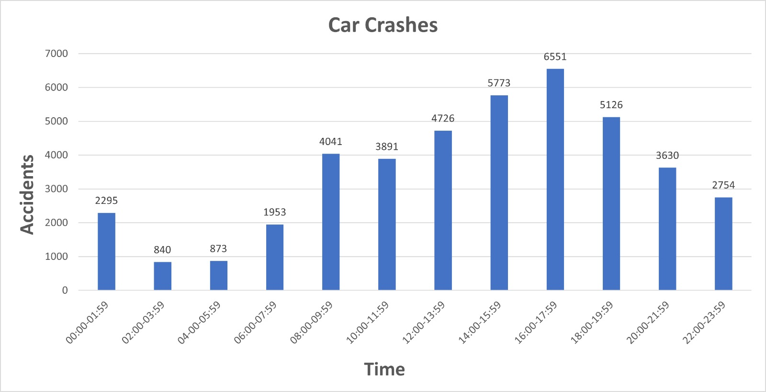
Findings
Car crashes can occur at any time and in various situations, making them unpredictable events that can have serious consequences. We conducted a comparative analysis of various data sets and visualized the results with charts, leading us to the conclusion that majority of accidents occur between 16:00 and 18:00
8

Slide 9
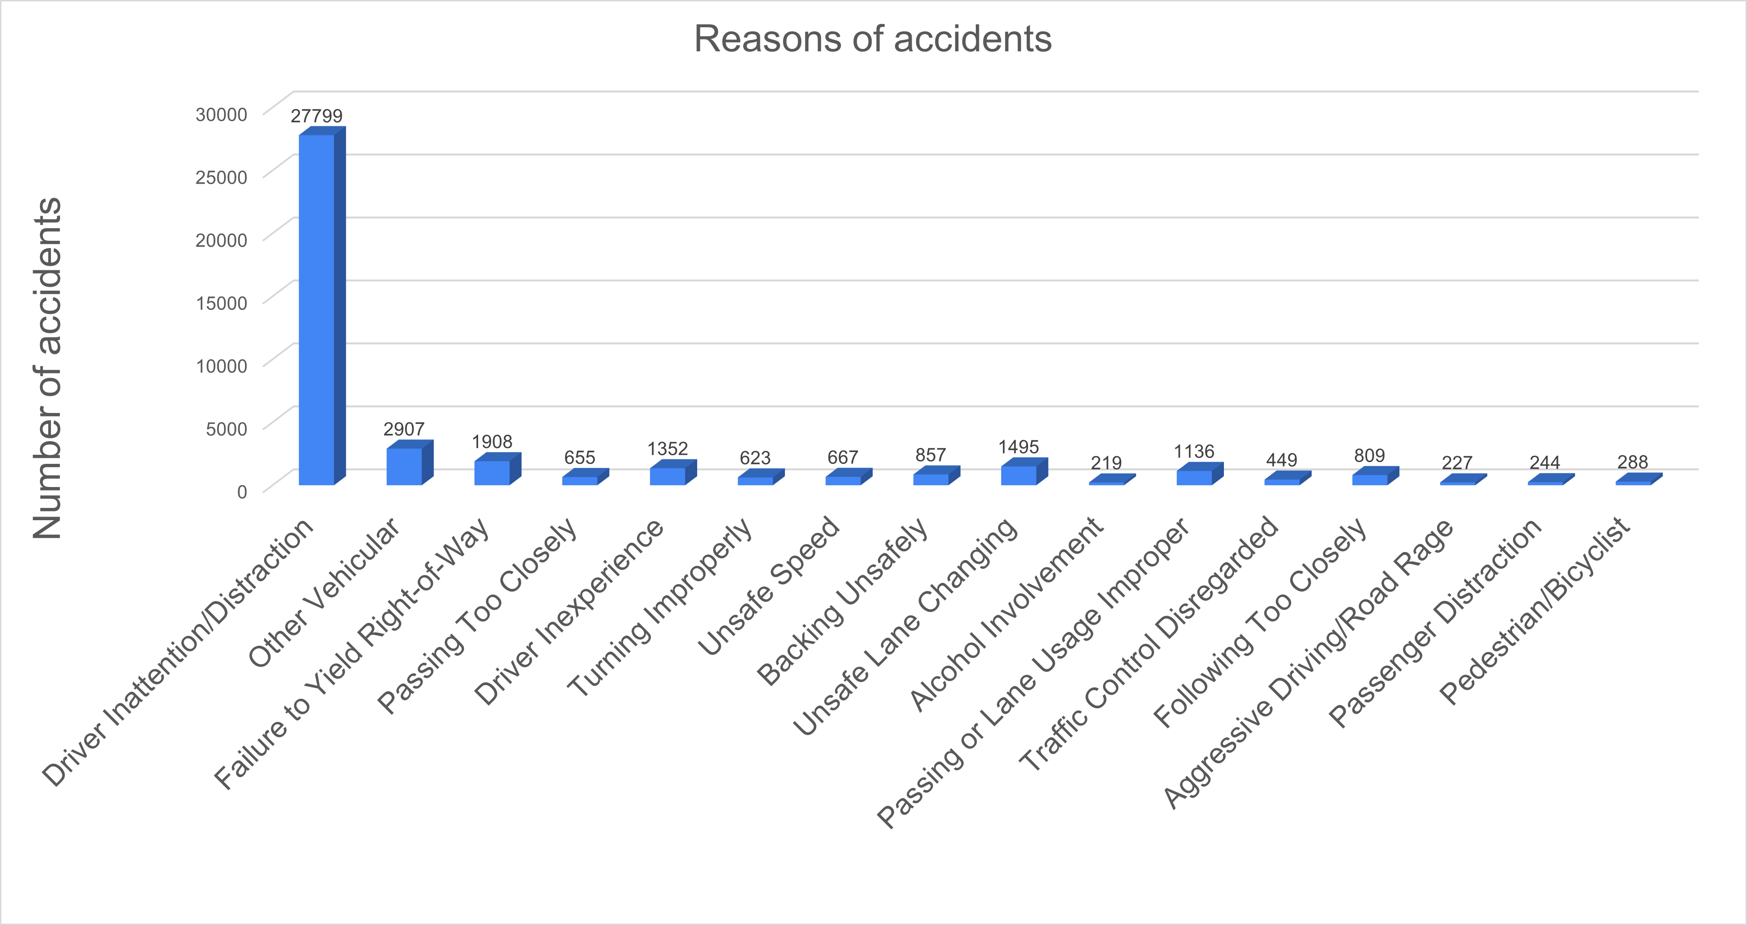
Findings
Accidents result from a range of factors, including driver behavior, weather conditions, vehicle issues, road infrastructure, and driver distraction. Driver distraction is indeed a leading cause of accidents on the road
9

Slide 10
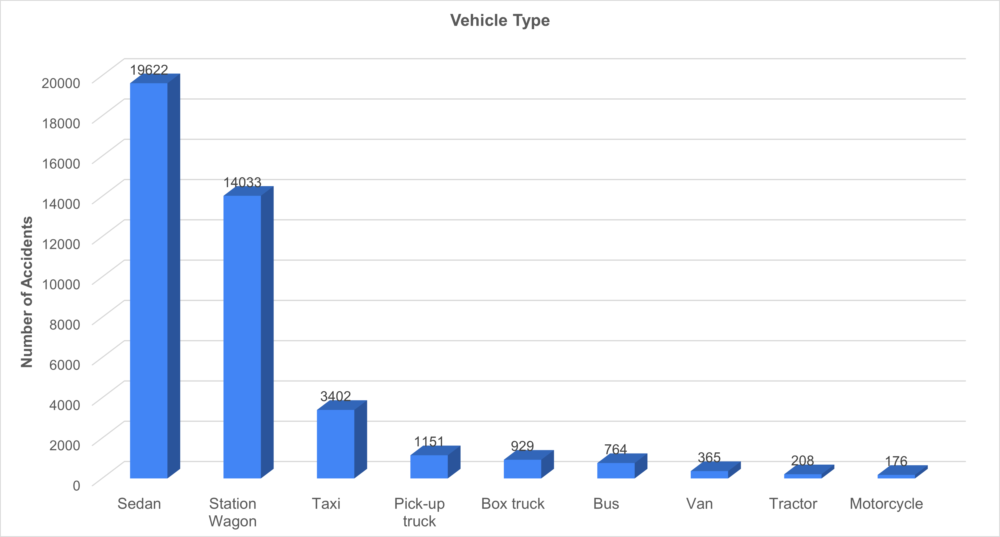
Findings
Most accidents are caused by sedan-type and station-wagon cars. The reason for this is people's preference for sedan and wagon cars in their daily lives.
10

Slide 11
Limitations
The dataset was based on US. There were 5 borough – Brooklyn, Manhattan, Queens, Staten Island, Bronx.
In this dataset we don’t have full detail about every accident. There were blank cells, that’s why we simplified it.
11

Slide 12
Conclusions
Time interval
We conducted a comparative analysis of various data sets and visualized the results with charts, leading us to the conclusion that the majority of accidents occur between 16:00 and 18:00.
Reasons of accidents
Driver distraction or inattention stands out as the leading cause of accidents.
Type of Vehicle
Sedan-type vehicles are frequently involved in accidents, largely due to the preference people have for them in their daily lives.
12

Slide 13
Solution
Technological Advances
Driver Assistance Systems (Auto Pilot)
Driver Training
13

Slide 14
References
Car Crashes Dataset - Kaggle
Car Crashes | Kaggle
14

Slide 15
THANKS

